Slide 1
Preaching Christ To The Gentiles
Acts 10

Slide 2
History Between Jews and Gentiles
Gentile, a person who is not Jewish. https://www.britannica.com
(cf. Genesis 10:5)
Jews and Gentiles in the Old Testament.
Genesis 12:1-3; Exodus 12:37; 38:26; Deuteronomy 7:6-8
Esther 9:1, 5
Jonah
Isaiah 2:2; Romans 11:25; cf. 11:11-14

Slide 3
Who Was Cornelius? Acts 10:1-8
Cornelius was a man of Caesarea.
He was a “Centurion” verse 1.
  What was his job?
He was a “devout” man.
Feared God with all of his household. verse 2
Charitable … He gave many alms to the Jewish people. verse 2.
Prayed to God continually. verse 2
He was a just man, of good report. verses 22, 24.
He needed the gospel. Acts 11:14

Slide 4
Cornelius and His Vision
Acts 10:1-8
God remembers His promise. 10:4-8
(Genesis 12:3; 22:18)
  All nations would be blessed in Abraham’s seed. Acts 2:39; 3:25-26
  The Seed is Christ. Galatians 3:16
  God will bring lost Gentiles into contact with the gospel of Christ and save them just like Jews were being saved. Acts 15:7-9
  Cornelius sent men to Joppa for Peter. 10:5-8

Slide 5
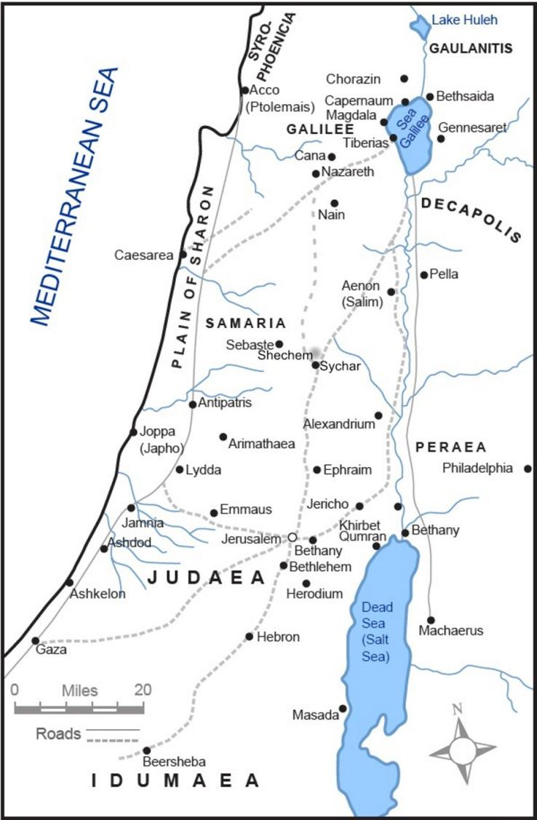
Cornelius sends for Peter
Acts 10:1-8
About 30 miles

Slide 6
Peter and His Vision
Acts 10:9-33
Convinced to go to a Gentile. 10:9-23
  Unclean meats forbidden by Law of Moses.
  Leviticus 11:46-47 (44-45)
    Christ purified all foods. Mark 7:19;
    1 Timothy 4:4-5
Devout Jews considered Gentiles unclean.
(Acts 10:28; 11:1-3)
    Gospel is for all, without partiality. 10:15, 34-35
    Therefore, Peter went without objection. 10:20, 28-29
    6 Jewish brethren went. 10:23, 45; 11:12

Slide 7
Peter and His Vision
Acts 10:9-33
Audience ready to hear. 10:24, 27, 33
  Peter explained how he got there. 10:28
  Cornelius explained why he sent for him. 10:29-33
  Prepared to hear the gospel of Christ. 10:33
  (Luke 8:8, 18)

Slide 8
Peter Preaches to Gentiles
Acts 10:34-43
Peter begins to preach Christ. 10:34-43; cf. Acts 2
God is impartial (fear and obey Him). 10:34-35
“Jesus Christ (He is Lord of all).” 10:36
Jesus was approved by God. 10:38
  Jews killed him. 10:39
  God raised him and witnesses saw him. 10:40-41
  Apostles charged to preach. 10:42 (Mark 16:15)
  Jesus the ordained Judge of all. 10:42
  All the prophets testified of him. 10:43
  “Whosoever” (KJV) believes receives remission of sins. 10:43

Slide 9
Miracles Involved With The Conversion Of Cornelius:
Cornelius saw a vision. (Verses 3-6) Miracle # 1
Something Cornelius must do.
Peter saw a vision. (Verses 9-16) Miracle # 2
Something Peter must do.
The Holy Spirit poured out. (Verse 44; 11:15) Miracle # 3

Slide 10
Why Was The Holy Spirit Given To Cornelius?
1. Not to save him. Acts 11:13-14; cf. James 1:21
2. Not to give faith. Acts 15:7
3. Not to purify heart. Acts 15:9
4. Not to give remission of sins. Acts 10:43; Acts 2:38
5. Not to purify soul. 1 Peter 1:22
6. Not to convert. Psalms 19:7
7. Not to sanctify. John 17:17
8. Not to beget them preparatory to the new birth. Men are begotten by the word of God.
1 Corinthians 4:15

Slide 11
Why Was The Holy Spirit Given To Cornelius?
To fulfill prophecy. Joel 2:28; cf. Acts 2:16ff
Not to change Cornelius, but for the instruction of Peter and the six Jews.
  Note: Peter’s response (10:47) and his arguments used at Jerusalem (11:17; 15:8-9); cf. 1 Corinthians 14:22
  Note: The Jews therefore, “Held their peace, and glorified God, saying, Then to the Gentiles also hath God granted repentance unto life.” Acts 11:18
Those six Jewish brethren who accompanied Peter, now had seen Gentiles speak with tongues and glorify God just as the Jews had some 8 - 10 years earlier. cf. Acts 10:23; 11:12, 15

Slide 12
Holy Spirit on Gentiles
Acts 10:44-48 (11:15-17)
The miracle. 10:44
Its effect on Gentiles. 10:46
Its effect on Jewish Christians. 10:45
  Peter remembered Pentecost. 11:15-17 (2:17)
  Confirmation of Gentile inclusion. 10:47-48

Slide 13
Holy Spirit on Gentiles
Acts 10:44-48 (11:15-17)
Result of this miracle. 10:47-48
  It was God’s testimony that Gentiles could become Christians (saved by faith in Christ Jesus). Acts 15:8-9
  God showed no distinction: The Lord saves ALL who believe and obey. 10:36, 43 (15:9)
  No one can forbid Gentiles the gospel and its blessings. Acts 2:37-38; 8:16, 36-38 (10:47)
The gospel includes the command to be baptized. 10:48; 1 Peter 3:21; Hebrews 5:9

Slide 14
Salvation of Gentiles
After visions, inspired instruction plus the Holy Spirit falling on Gentiles, Jewish Christians are convinced that Christ (His gospel and salvation) is for the whole world. cf. 11:18
The power of the gospel:
  Power to overcome prejudices, fears, and doubts, 10:34-35
  Power to overcome sin in all who believe and obey, 10:36, 43 (35)

Slide 15
How Was Cornelius Converted?
1. He heard the gospel. Acts 10:33
2. Believed the gospel. Acts 15:7
3. Repented. Acts 11:18
4. Baptized. Acts 10:48; cf. Acts 11:1; 2:41
The word was the instrument involved in the conversion of Cornelius. We too must hear and obey that same gospel.

